Slide 1
UNIVERSITY OF BARISHAL
Name: Akya Mony
Batch : 66
Topic: University of Barisal

Slide 2
"Barishal University is a prominent public university located in the southern part of Bangladesh, specifically in the Barishal division. Established in 2011, the university has quickly become a key educational institution in the region, offering a wide range of academic programs and research opportunities. Location: Situated in the picturesque surroundings of Barishal division, the university campus provides a serene and conducive environment for learning and research. Academic Programs: Barishal University offers undergraduate and postgraduate programs across various disciplines, including science, arts, social sciences, business studies, and more. These programs are designed"

Slide 4
DEPARTMENT | STUDENTS NUMBER | TEACHER’S NUMBER
CHEMISTRY | 80 | 9
Math | 80 | 13
PHYSICS | 80 | 11

Slide 5
DEPARTMENTS OF SCIENCE FACULTIES:
PHY
CHE
MATH
CSE
BU
STAT
BOTANY

Slide 6
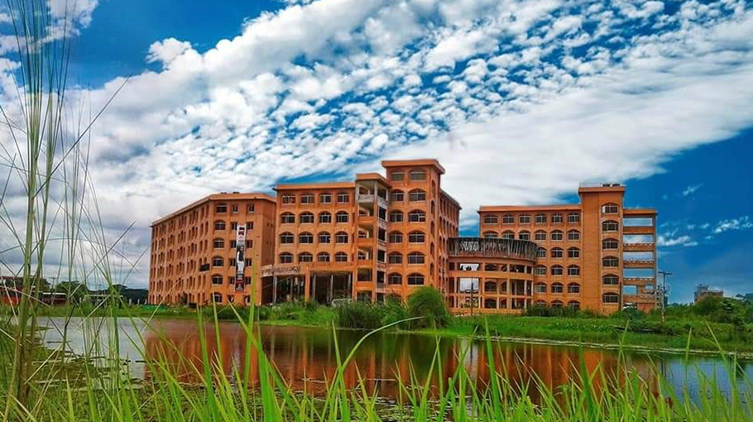
University of Barishal is a public university located in Barishal, a divisional city in southern Bangladesh. It is the country's 33rd public university. The university was established in 2011 and began academic activities at undergraduate level in six departments under four faculties on 24 January 2012

Slide 7
Choumatha
NATULLABAD
RUPATOLI
BU

Slide 8
THANK YOU

